Slide 1
Algorithm Design with Flowcharts

Slide 2
Introduction
Before writing a program to solve a particular problem, we must have a thorough understanding of the problem and a carefully planned solution approach.
© 2016 Pearson Education, Inc., Hoboken, NJ. All rights reserved.

Slide 3
Algorithms
The solution to any computing problem involves executing a series of actions in a specific order.
A procedure for solving a problem in terms of
  the actions to be executed, and
  the order in which these actions are to be executed
is called an algorithm.
Correctly specifying the order in which the actions are to be executed is important.
© 2016 Pearson Education, Inc., Hoboken, NJ. All rights reserved.

Slide 4
Algorithms (Cont.)
Consider the “rise-and-shine algorithm” followed by one junior executive for getting out of bed and going to work:
(1) Get out of bed,
(2) take off pajamas,
(3) take a shower,
(4) get dressed,
(5) eat breakfast,
(6) carpool to work.
This routine gets the executive to work well prepared to make critical decisions.
© 2016 Pearson Education, Inc., Hoboken, NJ. All rights reserved.

Slide 5
Algorithms (Cont.)
Suppose that the same steps are performed in a slightly different order: (1) Get out of bed, (2) take off pajamas, (3) get dressed, (4) take a shower, (5) eat breakfast, (6) carpool to work.
In this case, our junior executive shows up for work soaking wet.
Specifying the order in which statements are to be executed in a computer program is called program control.
© 2016 Pearson Education, Inc., Hoboken, NJ. All rights reserved.

Slide 6
Pseudocode
Pseudocode is an artificial and informal language that helps you develop algorithms.
Pseudocode is similar to everyday English; it’s convenient and user friendly although it’s not an actual computer programming language.
Pseudocode programs are not executed on computers.
Rather, they merely help you “think out” a program before attempting to write it in a programming language like C.
Pseudocode consists only of action and decision statements—those that are executed when the program has been converted from pseudocode to C and is run in C.
© 2016 Pearson Education, Inc., Hoboken, NJ. All rights reserved.

Slide 7
Control Structures
Normally, statements in a program are executed one after the other in the order in which they’re written.
This is called sequential execution.
Various C statements we’ll soon discuss enable you to specify that the next statement to be executed may be other than the next one in sequence.
This is called transfer of control.
© 2016 Pearson Education, Inc., Hoboken, NJ. All rights reserved.

Slide 8
Control Structures (Cont.)
Research had demonstrated that all programs could be written in terms of only three control structures, namely the
  sequence structure
  selection structure
  iteration structure.
© 2016 Pearson Education, Inc., Hoboken, NJ. All rights reserved.

Slide 10

Raptor
Mr. Lau Ka Lun
Lai King Catholic Secondary School

Slide 11
Introduction
RAPTOR is freely distributed as a service to the CS education community.
It was originally developed by and for the US Air Force Academy, Department of Computer Science.
It is free software.
RAPTOR is a flowchart-based programming environment.
to help students visualize their algorithms and avoid syntactic baggage.
RAPTOR programs are created visually and executed visually by tracing the execution through the flowchart.
Required syntax is kept to a minimum.

Slide 12
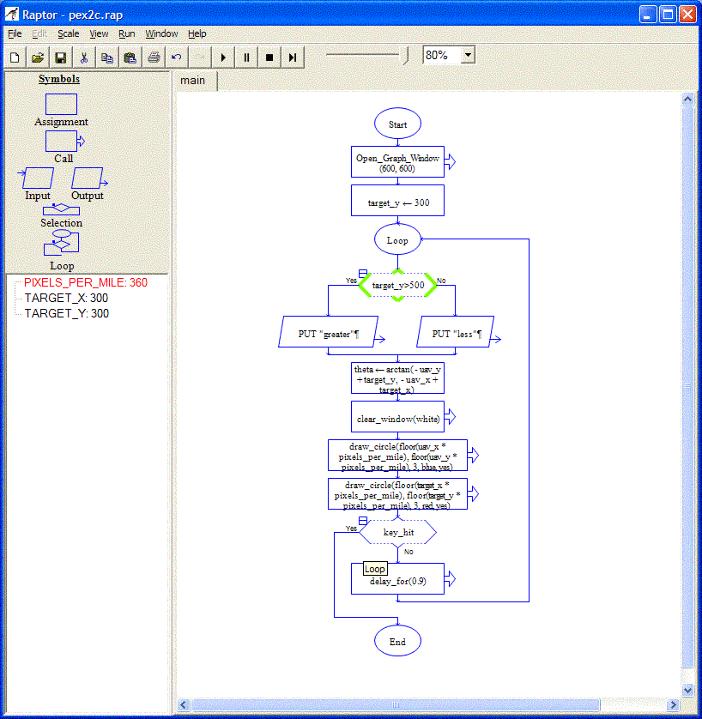
Website
http://raptor.martincarlisle.com/

Slide 13
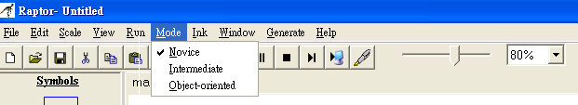
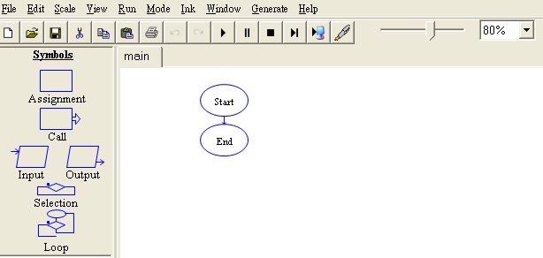
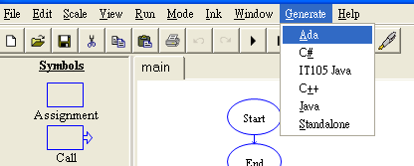
Layout
Mode -> Novice
Run the program
Pause
Stop
Speed of running
Generate source code

Slide 14
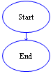
Program Structure
When executing a RAPTOR program, you begin at the Start symbol and follow the arrows to execute the program
A RAPTOR program stops executing when the End symbol is reached.

Slide 15
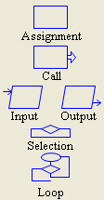
RAPTOR Statements/Symbols
The top four statement types:
  Assignment, Call, Input, and Output
The bottom two types:
  Selection and Loops

Slide 16
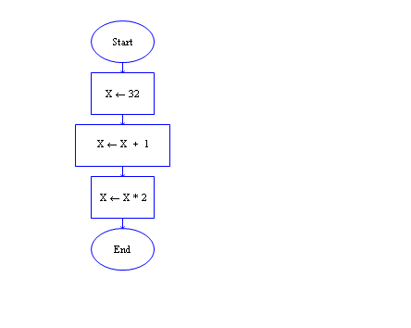
RAPTOR Variables
Description | Value of X
When the program begins, no variables exist. In RAPTOR, variables are automatically created when they are first used in a statement. | Undefined
The first assignment statement, X←32, assigns the data value 32 to the variable X. | 32
The next assignment statement, X←X+1, retrieves the current value of X, 32, adds 1 to it, and puts the result, 33, in the variable X. | 33
The next assignment statement, X←X*2, retrieves the current value of X, 33, multiplies it by 2, and puts the result, 66, in the variable X. | 66
Program

Slide 17
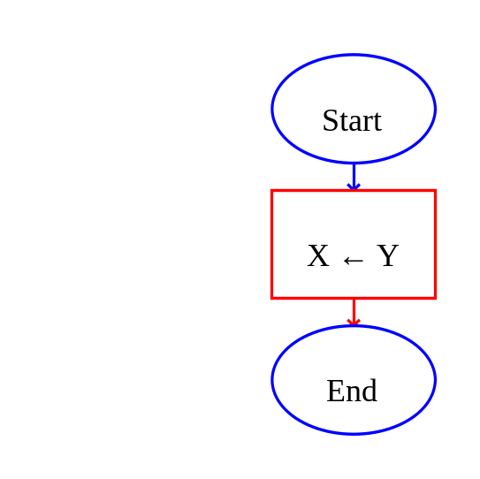
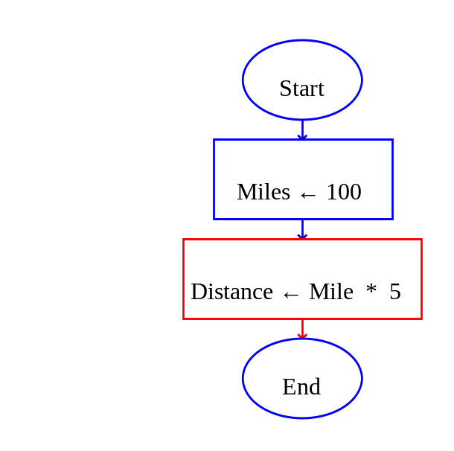
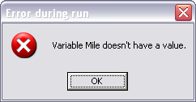
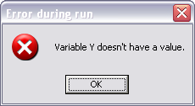
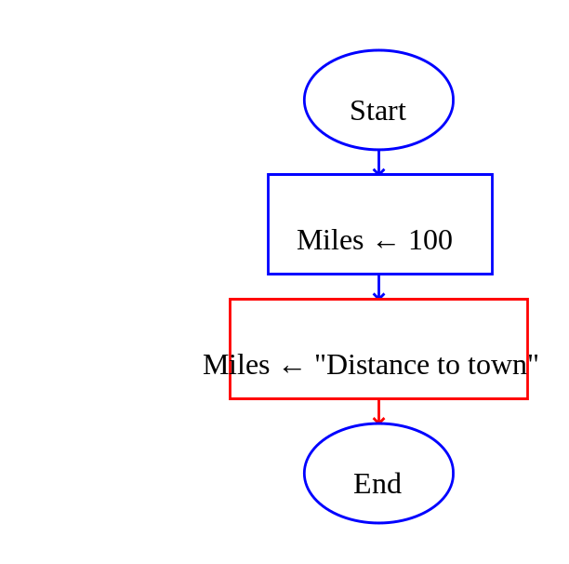
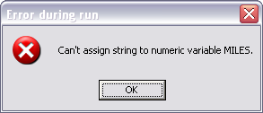
Common errors when using variables

Slide 18
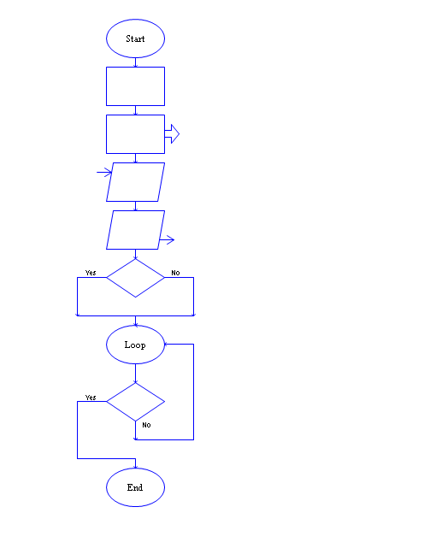
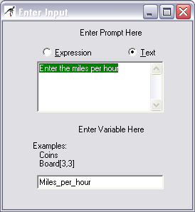
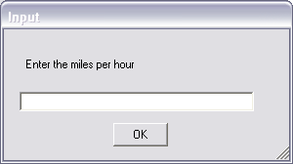
Input Statement/Symbol

Slide 19
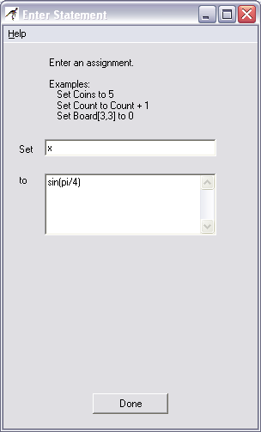
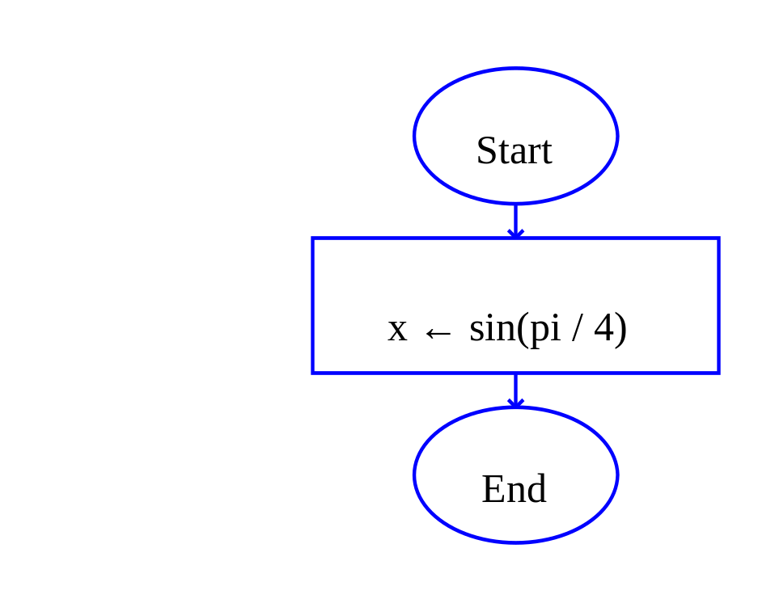
Assignment Statement/Symbol
Variable ← Expression

Slide 20
Operators and Functions
Operation | Description | Example
+ | addition | 3+4 is 7
- | subtraction | 3-4 is -1
- | negation | -3 is a negative 3
* | multiplication | 3*4 is 12
/ | division | 3/4 is 0.75
^ ** | exponentiation, raise a number to a power | 3^4 is 3*3*3*3=81 3**4 is 81
rem mod | remainder (what is left over) when the right operand divides the left operand | 10 rem 3 is 1 10 mod 4 is 2
sqrt | square root | sqrt(4) is 2
log | natural logarithm (base e) | log(e) is 1
abs | absolute value | abs(-9) is 9
ceiling | rounds up to a whole number | ceiling(3.14159) is 4
floor | rounds down to a whole number | floor(9.82) is 9
sin | trig sin(angle_in_radians) | sin(pi/6) is 0.5
cos | trig cos(angle_in_radians) | cos(pi/3) is 0.5
tan | trig tan(angle_in_radians) | tan(pi/4) is 1.0
cot | trig cotangent(angle_in_radians) | cot(pi/4) is 1
arcsin | trig sin⁻¹(expression), returns radians | arcsin(0.5) is pi/6
arcos | trig cos⁻¹(expression), returns radians | arccos(0.5) is pi/3
arctan | trig tan⁻¹(y,x), returns radians | arctan(10,3) is 1.2793
arccot | trig cot⁻¹(x,y), returns radians | arccot(10,3) is 0.29145
random | generates a random value in the range (0.0, 1.0] | random * 100 is some value between 0 and 99.9999
Length_of | returns the number of characters in a string variable | Example ← "Sell now" Length_of(Example) is 8

Slide 21
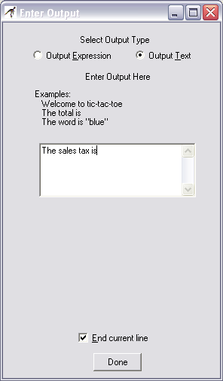
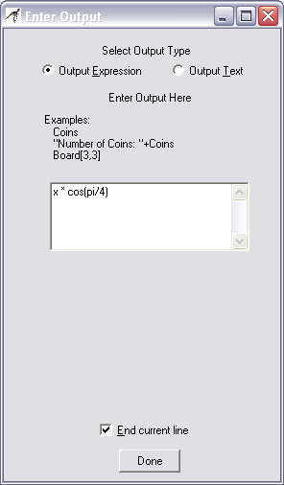
Output Statement/Symbol

Slide 22
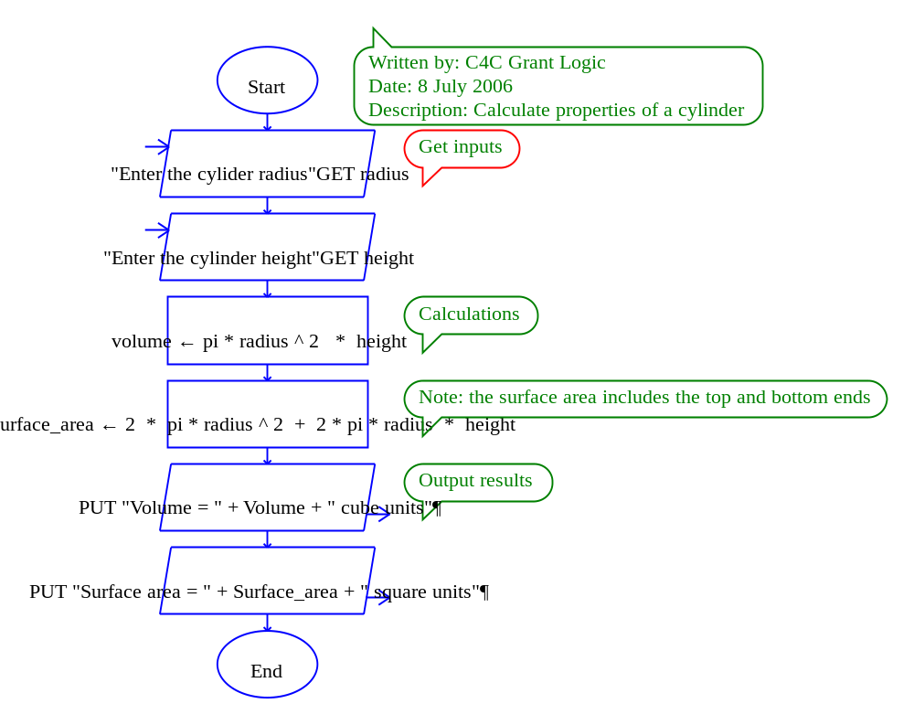
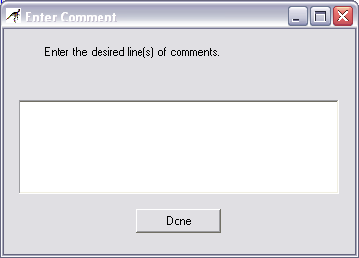
Comments in RAPTOR

Slide 23
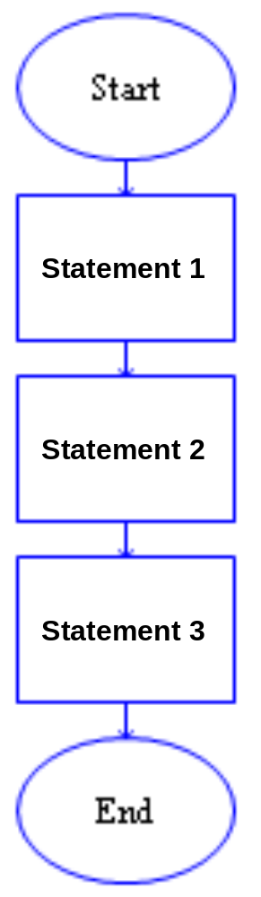
Sequential Program Control
in sequence
one-after-the-other

Slide 24
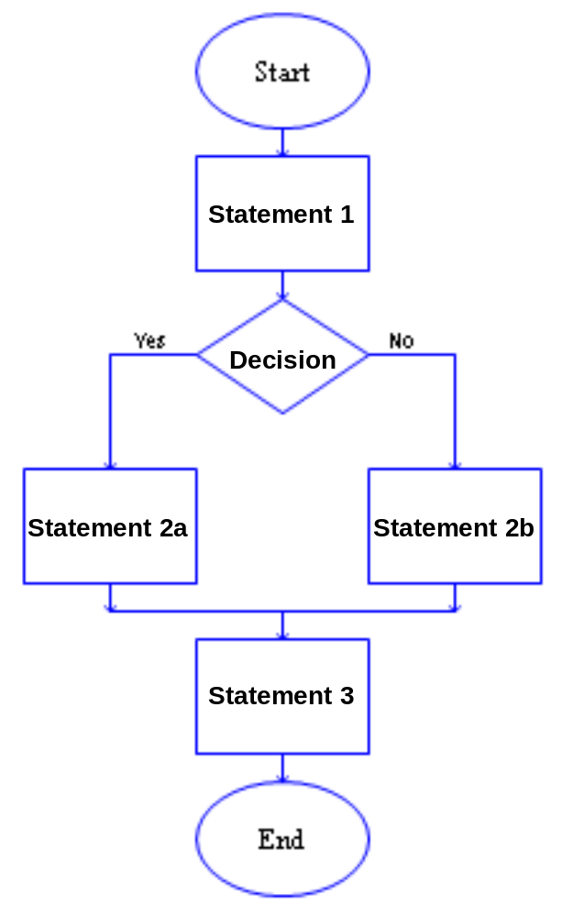
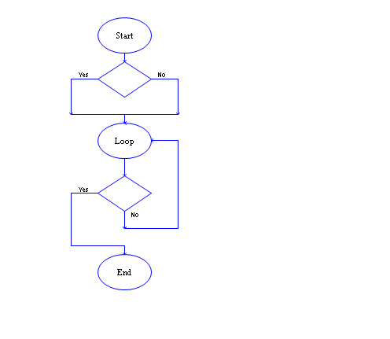
Selection Control

Slide 25
relational and logical operators
Operation | Description | Example
= | "is equal to" | 3 = 4 is No(false)
!= /= | "is not equal to" | 3 != 4 is Yes(true) 3 /= 4 is Yes(true)
< | "is less than" | 3 < 4 is Yes(true)
<= | "is less than or equal to" | 3 <= 4 is Yes(true)
> | "is greater than" | 3 > 4 is No(false)
>= | "is greater than or equal to" | 3 >= 4 is No(false)
and | Yes(true) if both are Yes | (3 < 4) and (10 < 20) is Yes(true)
or | Yes(true) if either are Yes | (3 < 4) or (10 > 20) is Yes(true)
xor | Yes(true) if the "yes/no" values are not equal | Yes xor No is Yes(true)
not | Invert the logic of the value Yes if No; No if Yes | not (3 < 4) is No(false)

Slide 26
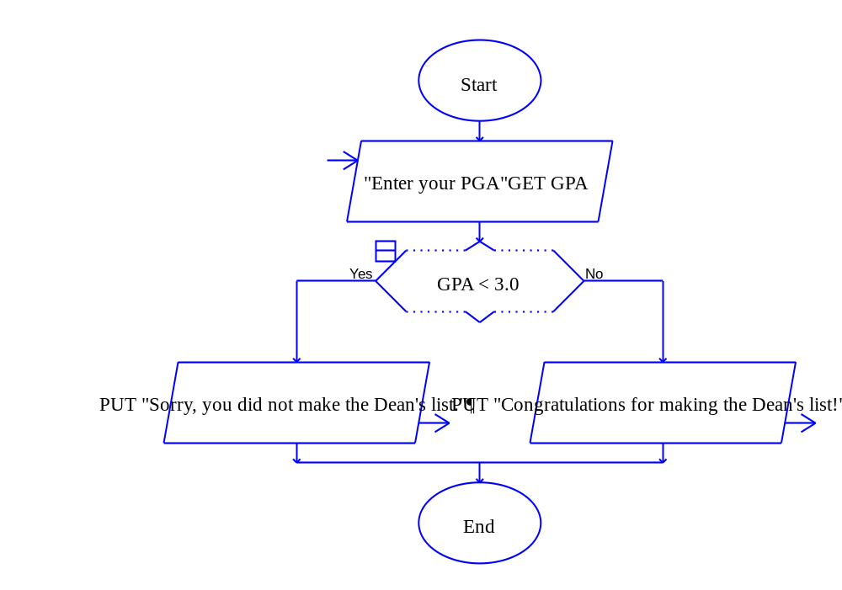
Selection Control Examples

Slide 27
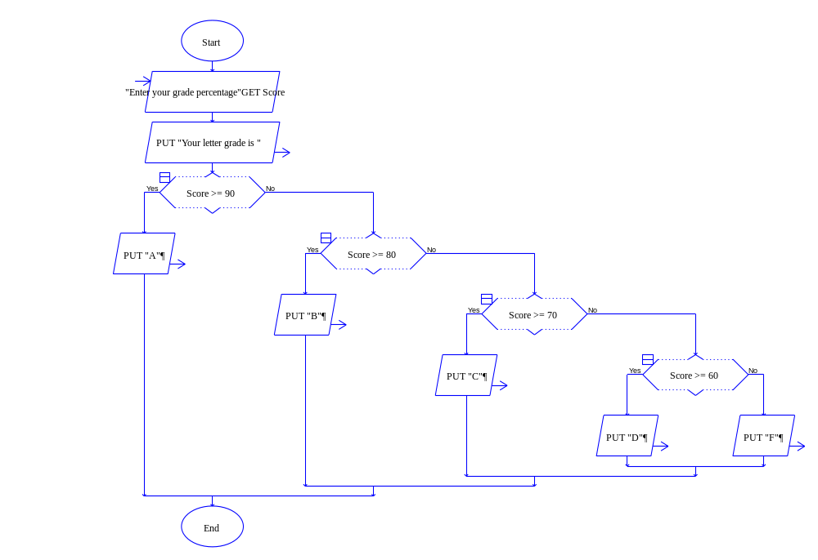
Cascading Selection statements

Slide 28
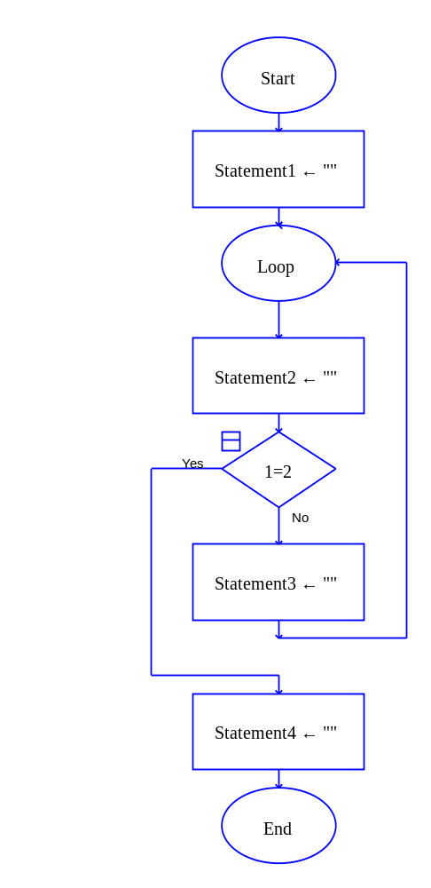
Loop (Iteration) Control

Slide 29
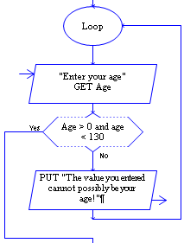
Input Validation Loops

Slide 30
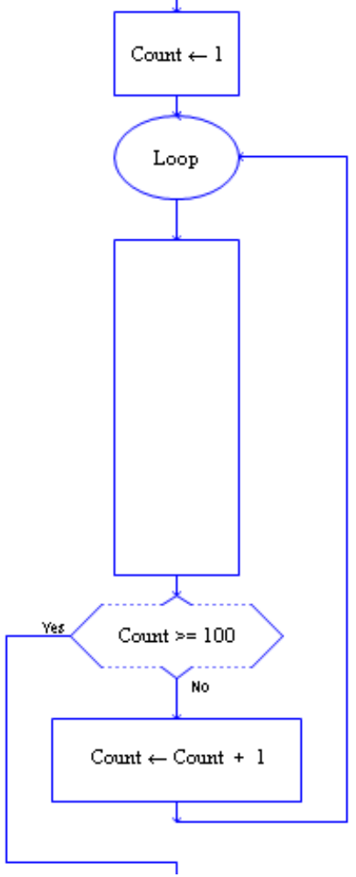
Counting Loops
Statements
to be repeated

Slide 31
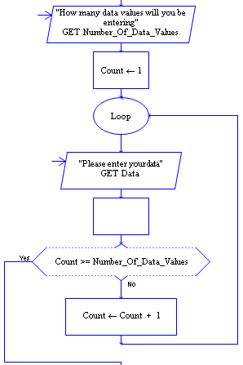
Input Loops

Slide 32
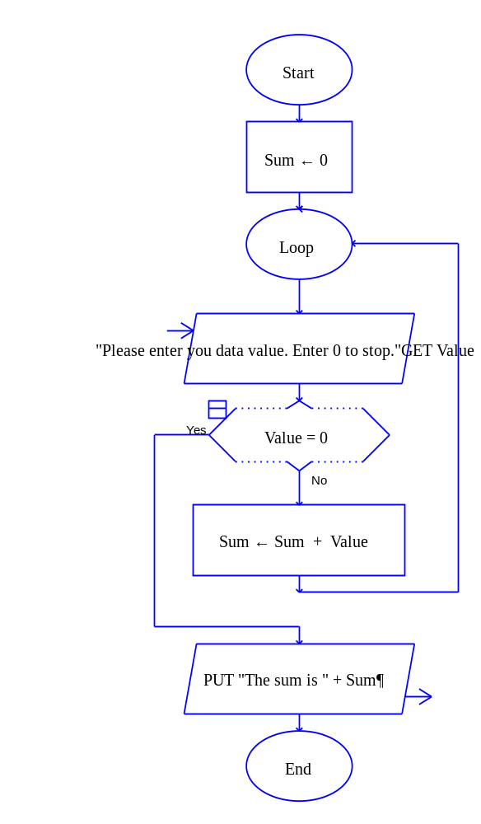
"Running Total" Loops

Slide 33
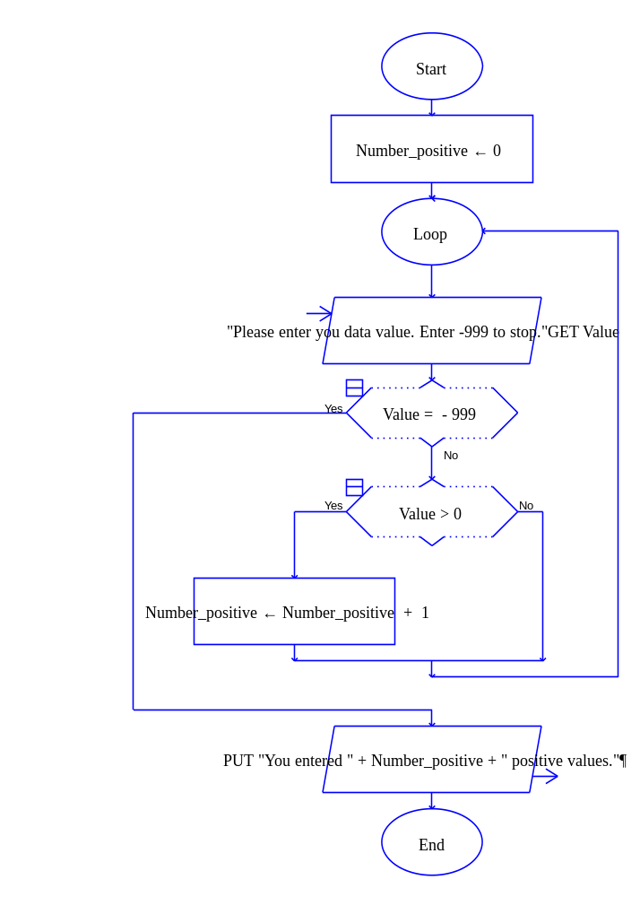
"Counting" Loops

Slide 34
Exercises
Write a series of RAPTOR statements that determines if X has the value 1, 2, or 3, and prints out “ONE”, “TWO”, or “THREE” accordingly.
Write a complete program that converts between degrees Fahrenheit and Celsius. The user must first enter the conversion that is desired (F to C or C to F) using any means you want and then enter the value to be converted. The formulas for conversion are:
F = 9/5 C + 32 and C = 5/9 (F – 32)
Write a complete program that plays the game of HI-LO. The program asks one user for a number between 1 and 100 and verifies that such a number has been entered. It then asks a second user for a guess and reads it in. If the guess is correct a congratulation message is written to the screen and the program ends. Otherwise the message “HI” or “LOW” is displayed (if the guess is higher or lower) and another guess is asked for and read in.

